Slide 1
Indicators and Historical Data

Slide 2
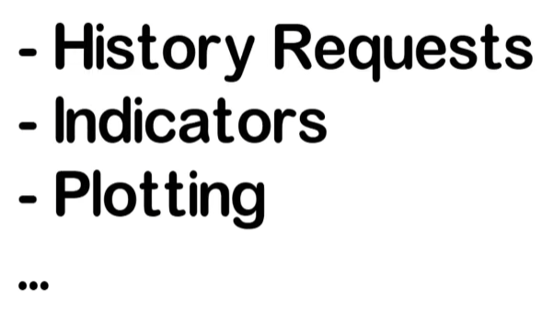

Slide 3
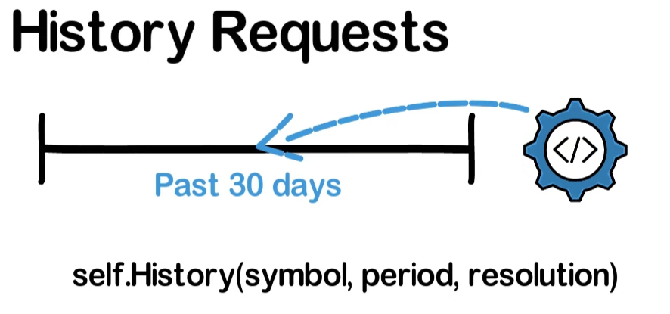
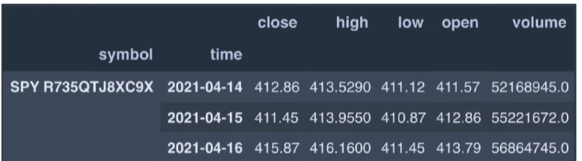

Slide 4
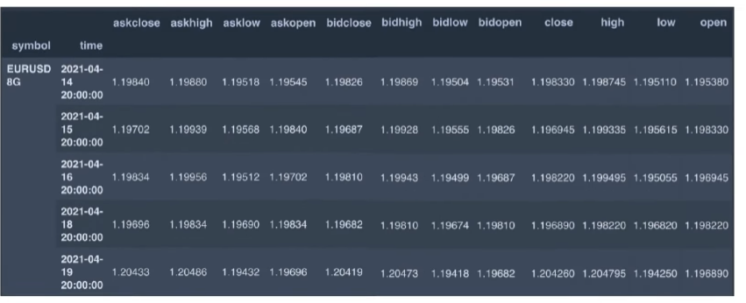

Slide 5
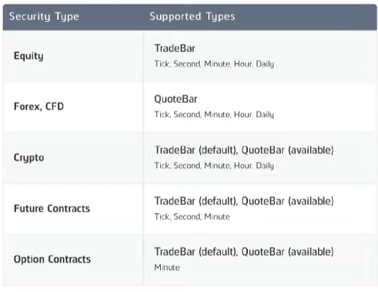

Slide 6
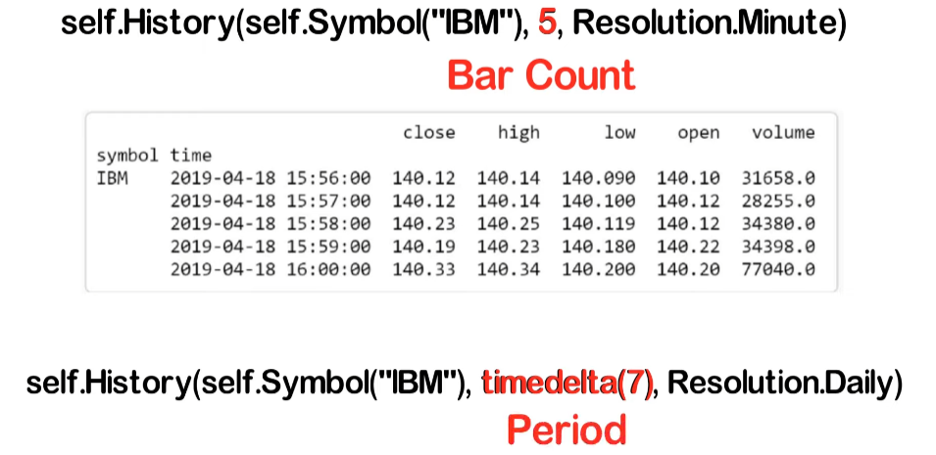

Slide 7
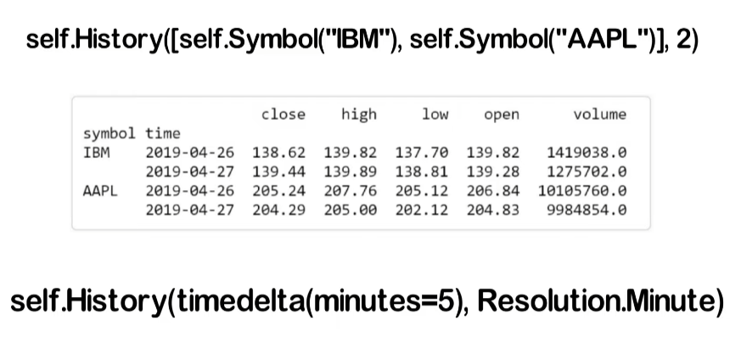
Request history data of all securities in your algorithm universe.
Note that this will return an array of slice objects
Keeps on requesting historical data is inefficient. A correct way is to use a rolling window, which will be covered in the next video.

Slide 8
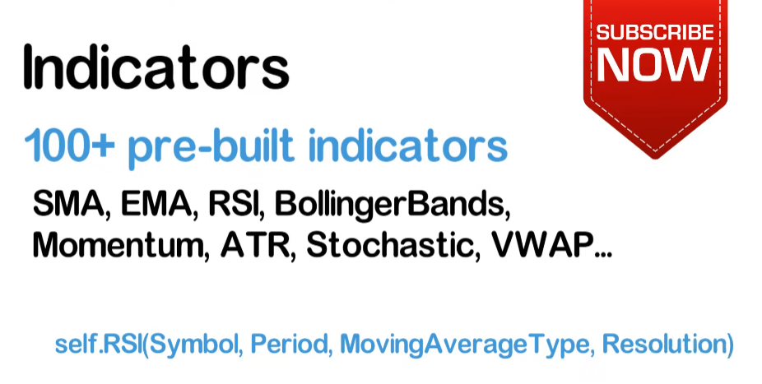
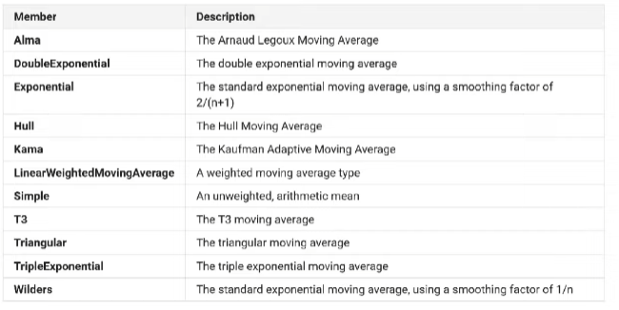

Slide 9
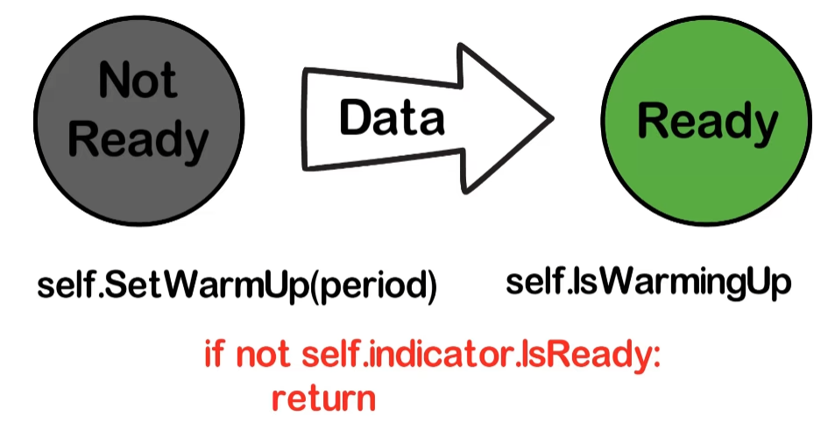

Slide 10
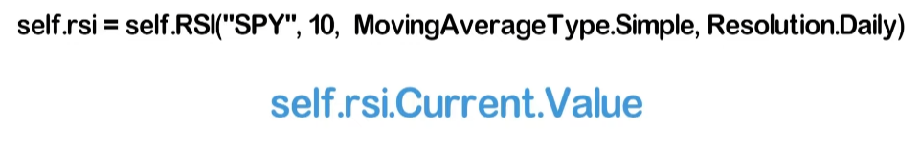

Slide 11
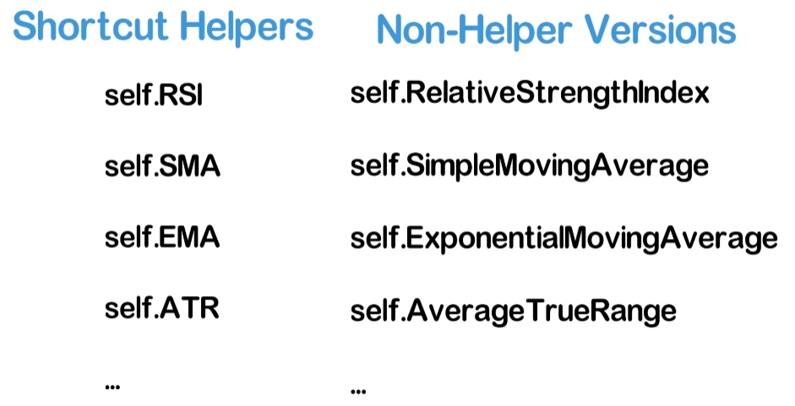
Shortcut Helpers are less flexible and auto-updated.
The non-helper versions allow more customization, but they need to be registered for auto-update or manually updated. See next slide.

Slide 12
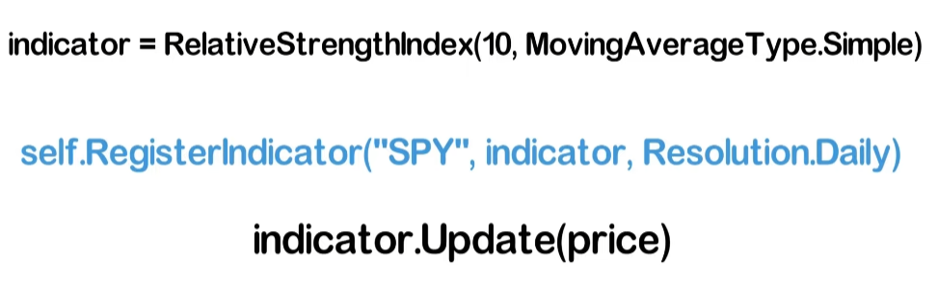
Register for auto-update
Manually update

Slide 13
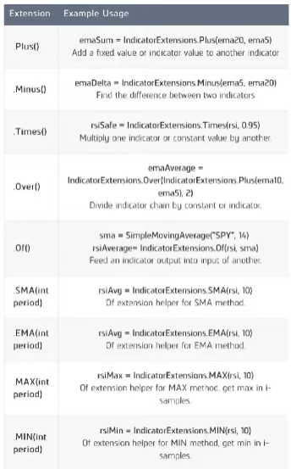
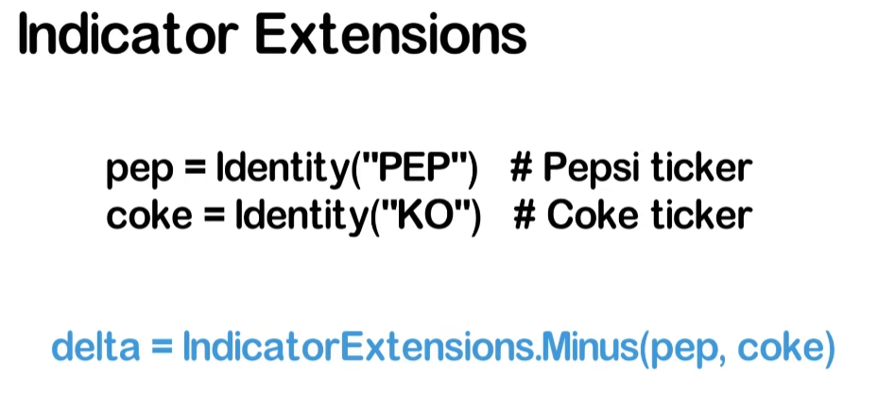

Slide 14
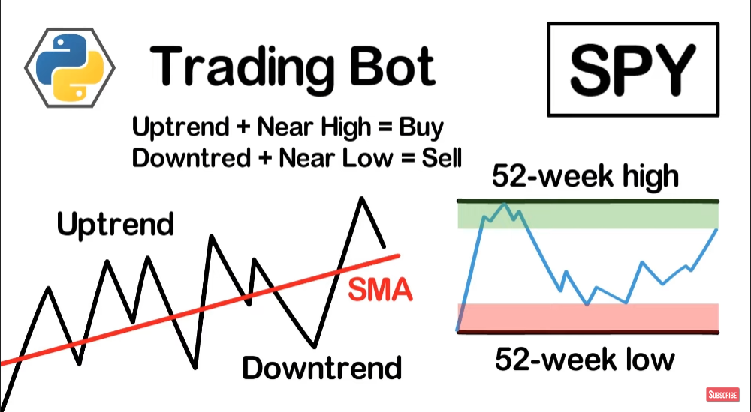

Slide 15
See the coding file – it also contains how to write your customized moving-average indicator

Slide 16
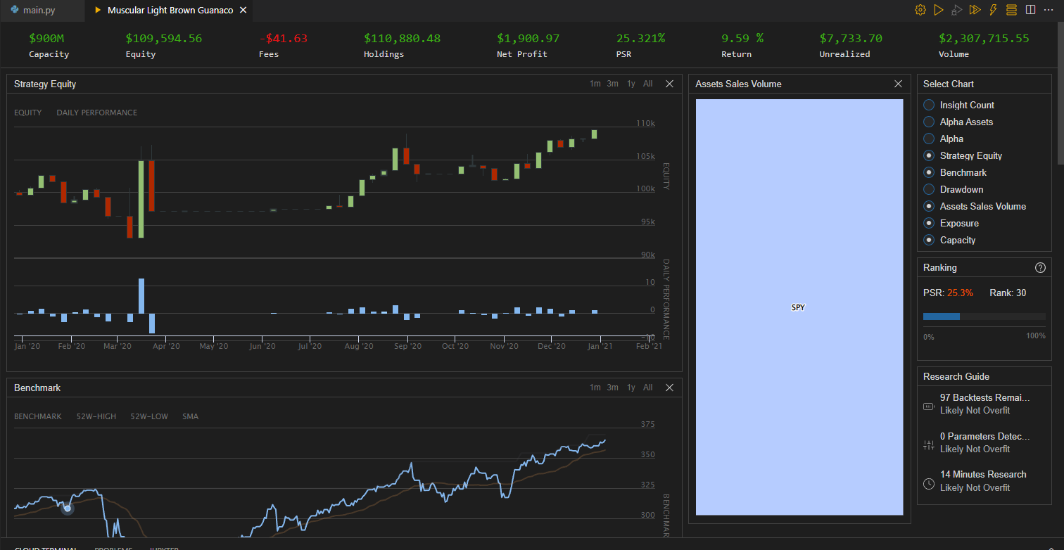

Slide 17
QuantConnect Indicators reference table: https://www.quantconnect.com/docs/v2/writing-algorithms/indicators/key-concepts?ref=v1#Indicators-Reference-Table?ref=towm

